Slide 1
Design & Analysis of Algorithms
Lecture # 01
Muhammad Waqas Sheikh
Research Fellow (FAST-NUCES)

Slide 2
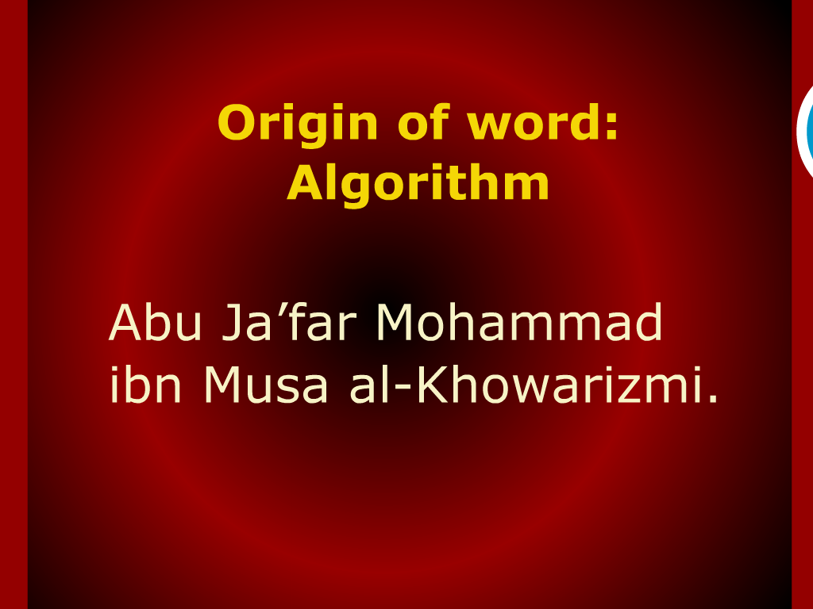
Notes:
Uzbakistan -> Khewa

Slide 3

Origin of Word: ALGORITHM

Slide 4
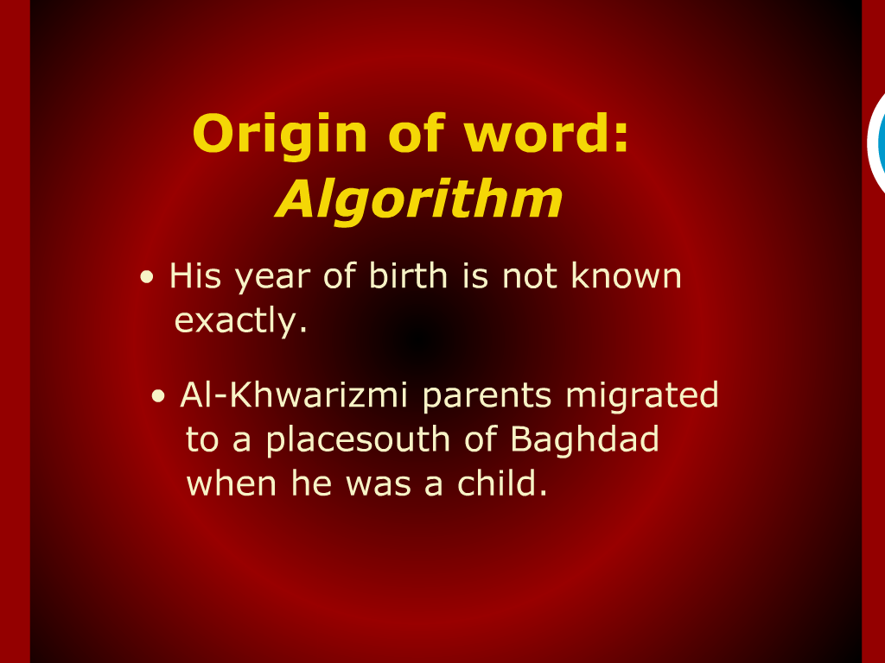
Origin of Word: ALGORITHM

Slide 5
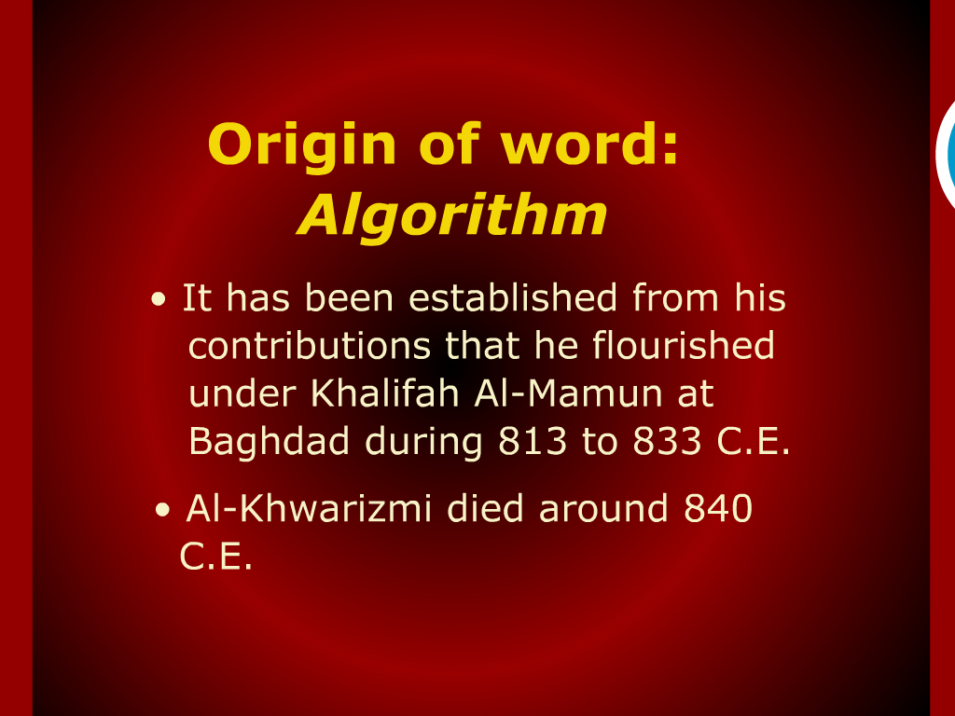
Origin of Word: ALGORITHM

Slide 6

Origin of Word: ALGORITHM

Slide 7
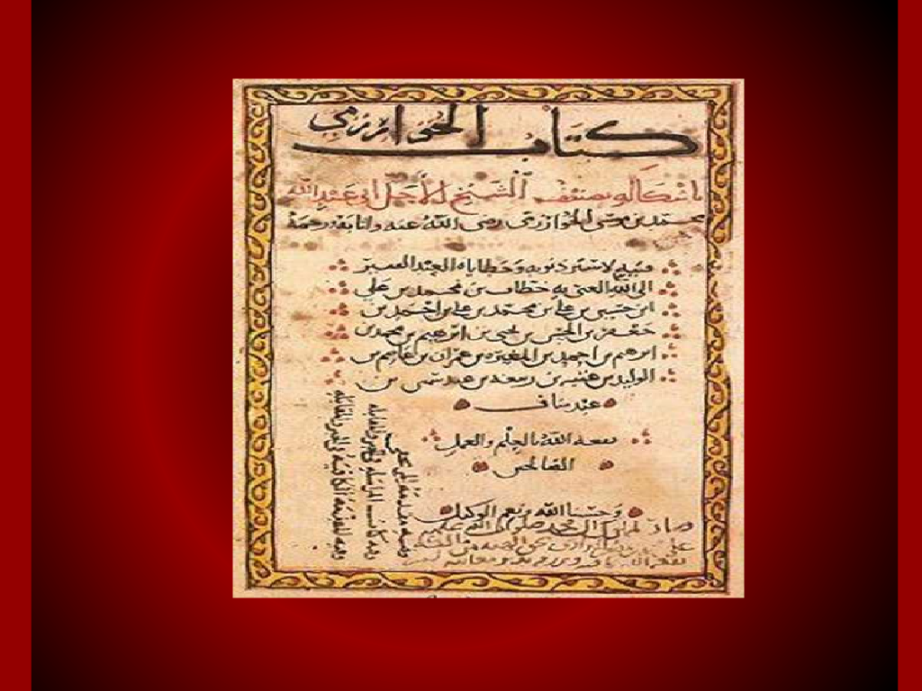
Origin of Word: ALGORITHM

Slide 8
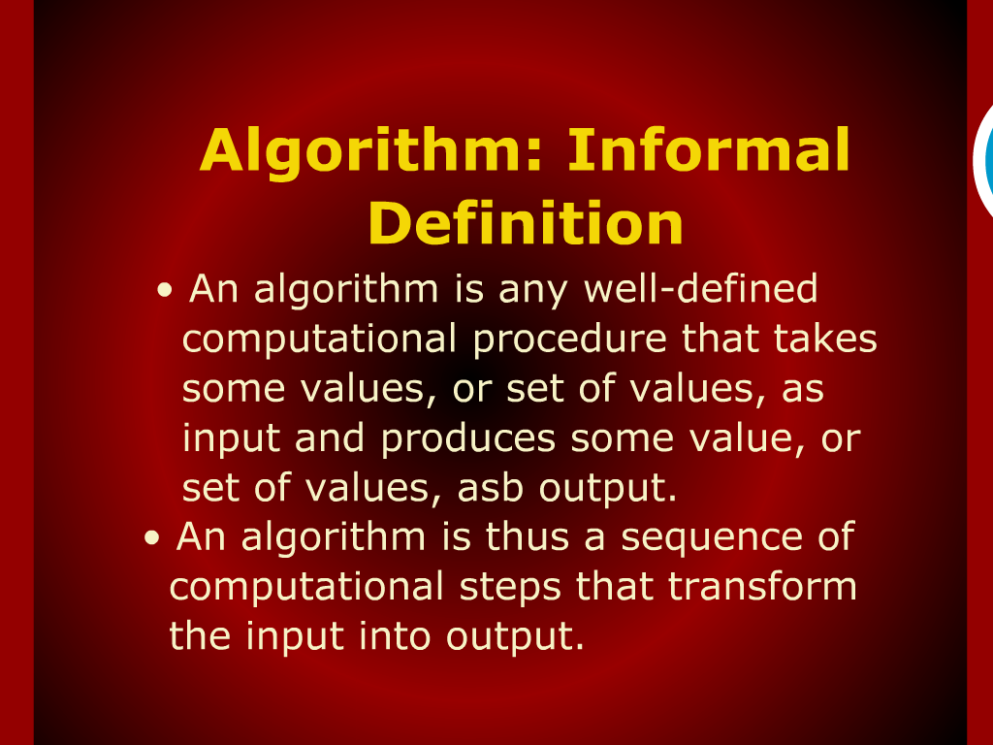
ALGORITHM informal definition

Slide 9
What is an algorithm?
An algorithm is a sequence of unambiguous instructions for solving a problem, i.e., for obtaining a required output for any legitimate input in a finite amount of time.
problem
algorithm
“computer”
input
output

Slide 10
Algorithm
An algorithm is a sequence of unambiguous instructions for solving a problem, i.e., for obtaining a required output for any legitimate input in a finite amount of time.
Can be represented various forms
Unambiguity/clearness
Effectiveness
Finiteness/termination
Correctness

Slide 11
What is an algorithm?
Recipe, process, method, technique, procedure, routine,… with the following requirements:
Finiteness
terminates after a finite number of steps
Definiteness
rigorously and unambiguously specified
Clearly specified input
valid inputs are clearly specified
Clearly specified/expected output
can be proved to produce the correct output given a valid input
Effectiveness
steps are sufficiently simple and basic
Notes:
The formalization of the notion of an algorithm led to great breakthroughs in the
foundations of mathematics in the 1930s.

Slide 12
What are algorithms?
Why is the study of algorithms worthwhile?

Slide 13
Why is the study of algorithms worthwhile?
Suppose computers were infinitely fast and computer memory was free
Would you have any reason to study algorithms?
The answer is “YES”
To demonstrate that your solution method terminates and does so with the correct answer.

Slide 14
Why is the study of algorithms worthwhile?
Processing Time is a bounded resource.
computers may be fast, but they are not infinitely fast. And memory may be inexpensive, but it is not free.
use these resources wisely
Insertion and Merge Sort ?

Slide 15


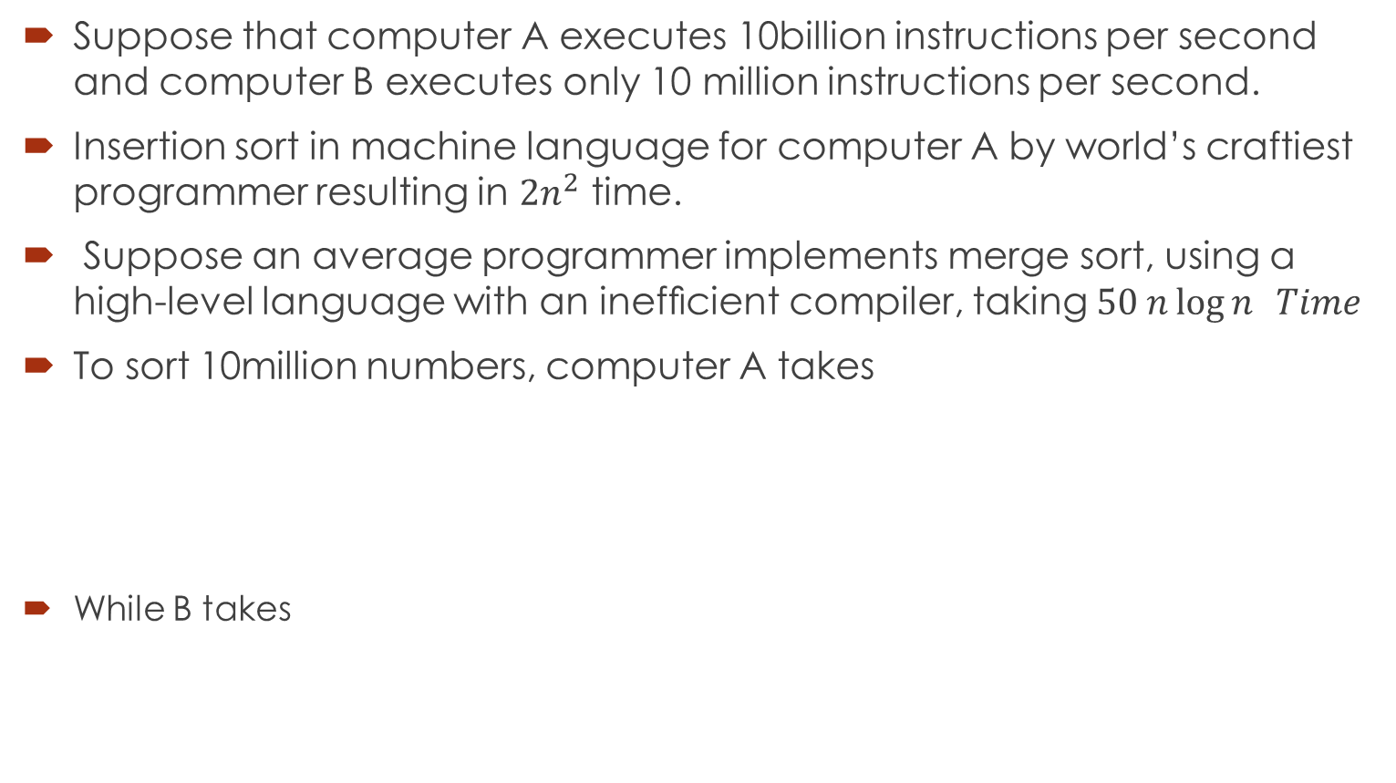
Why is the study of algorithms worthwhile?
Suppose that computer A executes 10billion instructions per second and computer B executes only 10 million instructions per second.
Insertion sort in machine language for computer A by world’s craftiest programmer resulting in $2n^{2}$ time.
Suppose an average programmer implements merge sort, using a high-level language with an inefﬁcient compiler, taking $50 n\log{n } Time$
To sort 10million numbers, computer A takes
While B takes

Slide 16
Two main issues related to algorithms
How to design algorithms
How to analyze algorithm efficiency

Slide 17
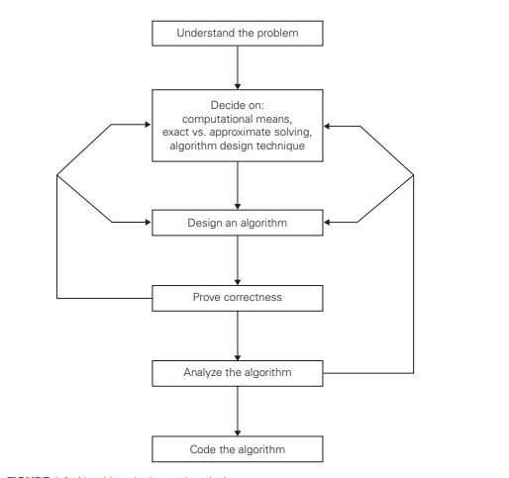

Slide 18
Algorithm design techniques/strategies
Brute force
Divide and conquer
Decrease and conquer
Transform and conquer
Space and time tradeoffs
Greedy approach
Dynamic programming
Iterative improvement
Backtracking
Branch and bound

Slide 19
Analysis of algorithms
How good is the algorithm?
time efficiency
space efficiency
Does there exist a better algorithm?
lower bounds
optimality

Slide 20
Important problem types
sorting
searching
string processing
graph problems
combinatorial problems
geometric problems
numerical problems

Slide 21
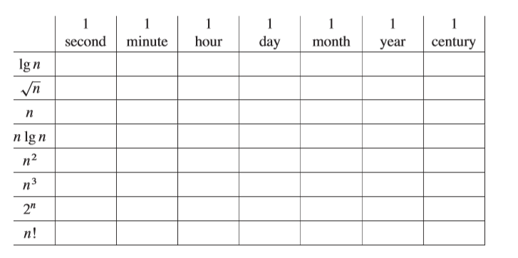
Problem
Comparison of running times For each function f(n) and time t in the following table, determine the largest size n of a problem that can be solved in time t, assuming that the algorithm to solve the problem takes microseconds.

Slide 22
Euclid’s Algorithm
Problem: Find gcd(m,n), the greatest common divisor of two nonnegative, not both zero integers m and n
Examples: gcd(60,24) = 12, gcd(60,0) = 60, gcd(0,0) = ?
Euclid’s algorithm is based on repeated application of equality
gcd(m,n) = gcd(n, m mod n)
until the second number becomes 0, which makes the problem
trivial.
Example: gcd(60,24) = gcd(24,12) = gcd(12,0) = 12
Notes:
Euclid’s algorithm is good for introducing the notion of an algorithm because it
makes a clear separation from a program that implements the algorithm.
It is also one that is familiar to most students.
Al Khowarizmi (many spellings possible...) – “algorism” (originally) and then
later “algorithm” come from his name.

Slide 23
Other methods for computing gcd(m,n)
Consecutive integer checking algorithm
Step 1 Assign the value of min{m,n} to t
Step 2 Divide m by t. If the remainder is 0, go to Step 3; otherwise, go to Step 4
Step 3 Divide n by t. If the remainder is 0, return t and stop; otherwise, go to Step 4
Step 4 Decrease t by 1 and go to Step 2
Is this slower than Euclid’s algorithm? How much slower?
Complexity : O(log n)

